Slide 1

SUP Performance
Planning

Slide 2

Performance
Paddle
Group
(PPG)

Slide 3
Resources
Website
https://clydewindsurfing.co.uk
https://clydesup.co.uk/(for PPG Only)
Facebook Page https://www.facebook.com/clydewindsurfing/
Facebook Group
https://www.facebook.com/groups/409541942824948
Email
admin@clydewindsurfing.co.uk

Slide 4
Today
Why Race
Paddling Faster Basics
Turning Faster Basics
Exercise of the week
Key Races
Annual Training Plans Basics
Sabotage
Goals, Beliefs and Trust
Mental Resilience Toolkit Part 1
Self Talk
Homework Exercise :-o

Slide 5

WHY

Slide 6
Why Race
Why Race?
Racing is really hard work
You need to train if you want to improve
Nobody at work will have heard of the races you are entering
Young bendy people make it all look so easy
So why bother Racing?
Community:
It’s great to hang out with like minded and positive people.
Challenges:
It’s a great Bucket List item.
Lots of challenge mixed in with heaps of achievement
You get to set and exceed your own goals

Slide 7
Why Race
Health & Fitness:
It will make you fitter and get you outside more often
Self Improvement:
Racing will provide the means to improve yourself all the way from from Fitness to Mental Health. And hopefully this will make you feel good 😊
Fun:
Sometimes it is fun at the time (Type 1 fun) 😊
Sometimes it is fun 3 days later when you are sitting at a desk wishing you were back out on the water (Type 2 fun) 😐
It is also fun to watch other people racing 😊
Mental Health:
It really takes you out of the every day groove and into a different place.
Sprints and Technical races do this instantly.
Endurance racing is more of an acquired taste. It takes a while but once you are hooked it may become a lifelong obsession.
There are loads of reasons to race and as you improve, your motivations will change. Its worth looking at Goals and deciding what ones suit you now.

Slide 8
WHY

Slide 9
Paddle Faster
To paddle faster you just need to:
Breathe
Breathe in and out every stroke. If that is too fast then do every 1.5 strokes or every 2 strokes.
Really concentrate on Breathing Out. Breathing in is the easy part
Look where you are going:
This will make you paddle a straighter course
Use your whole body and not just your arms
This include dropping your body weight onto the paddle at the catch and using it as an advantage
Pull the paddle in a straight line:
Don’t follow the curve of the boards rail
Smooth the board out:
Don’t bounce up and down or rock from side to side too much.
Paddle more strokes per minute:
More strokes means more speed.
It is not about pulling the blade harder. All the quick wins are on the Exit, Recovery, Reach and Catch.
“So you know that nice slow bit you do to recover in between each stroke....That needs to speed up....A LOT”

Slide 10
Paddle Faster
Count your strokes when things get tough.
It takes your mind off of things
It also helps with a nice smooth rhythm
Prepare self talk for when things go wrong.
If you always fade in the middle of the race, then prepare for this.
Prepare whatever motivational words you need to get you through.
Know your Goals
Why does this race matter. Why are you doing it
Do you have a Nemesis that you simply “Must Beat”
If it matters enough, then you can motivate yourself
If it does not, then chill a little, and just enjoy a slightly slower race.
Fuel yourself
Start Fueled
Drink enough
Eat enough of the right things, but not too much
Enjoy Yourself
Although it might take a couple of days to realise that you were having fun.
Notes:
Mindfulness, being free of both the past and future
750ml an hour
One gram of carbohydrate per kilo of bodyweight, per hour
60 grams of a single type of carbohydrates
90 grams of mixed carbohydrates (60 Glucose 30 Fructose)

Slide 11
Turn Faster
Sweep
Buoy Turns
Cross Bow Rudder

Slide 12
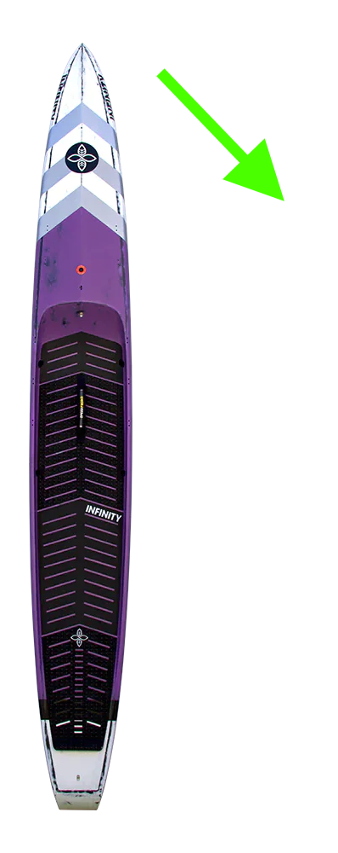
Turn Faster
Sweep

Slide 13
Turn Faster
Sweep
https://youtube.com/clip/UgkxPV-YZhAaT4RPTvRYh7rnJawYpKT8YsNb?feature=shares

Slide 14
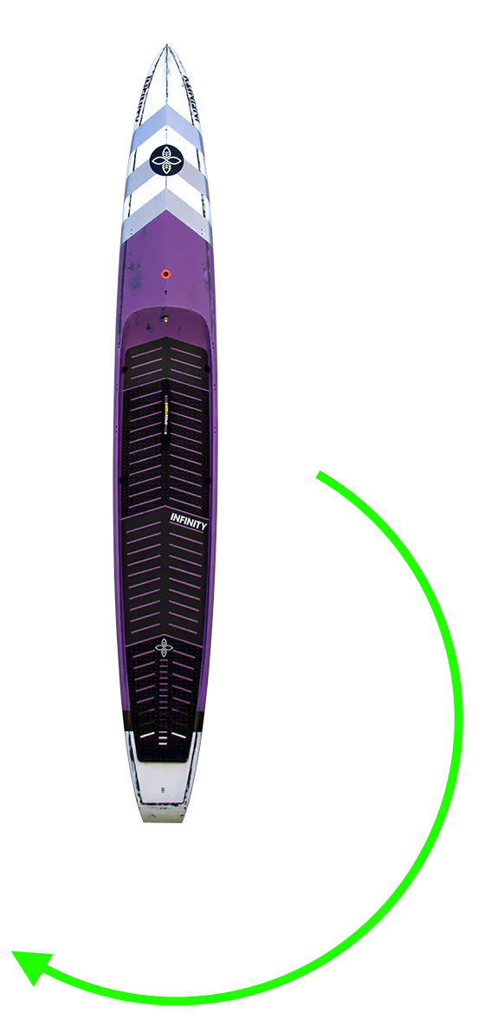
Turn Faster
Buoy Turns

Slide 15
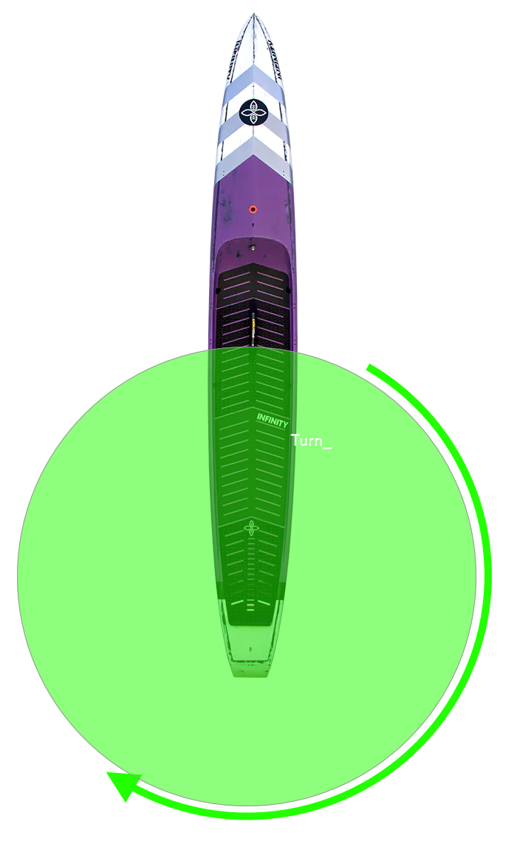
Turn Faster
Buoy Turns

Slide 16
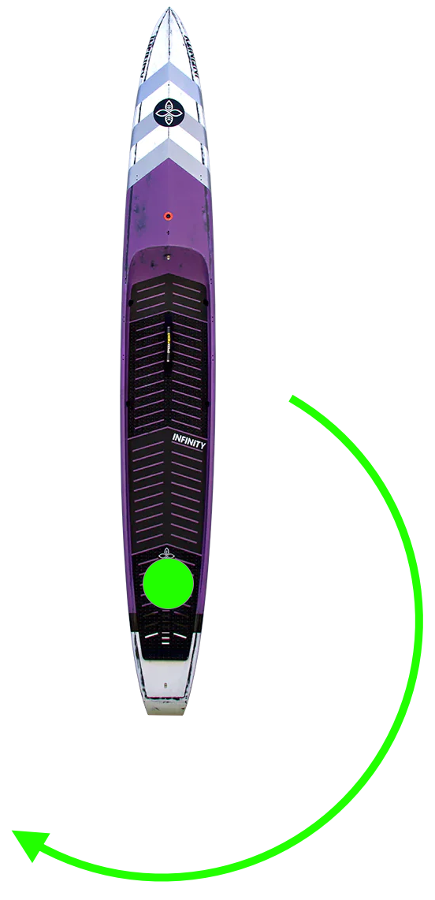
Turn Faster
Buoy Turns

Slide 17
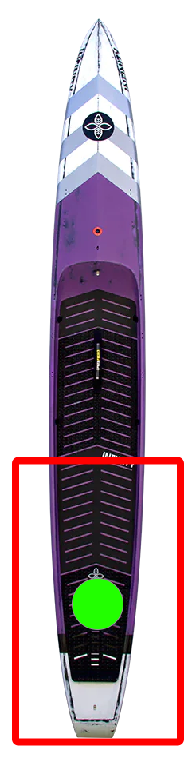
Turn Faster
Buoy Turns

Slide 18

Turn Faster
Buoy Turns

Slide 19
Turn Faster
Good
https://www.youtube.com/clip/UgkxSmtQmXqODEdbuwbI9JkBHi_BhgYKHOvx
Better
https://www.youtube.com/clip/UgkxadK9Wg-r0PLi-fm0wfC0BmNBg6bSVZx5
Best
https://www.youtube.com/clip/UgkxihP-zqjWAKAbl6P02qmBbI0fL3uwg8DS
https://www.youtube.com/clip/Ugkx7Iof9IHhx40No1gAuZ7IXLA_8EweSksr
https://www.youtube.com/clip/UgkxeS71yDuEcQngUV8F3vF-Dm1uHXK8vw0u?feature=shares
\
https://www.youtube.com/clip/UgkxE5h8demmzY-k89sujnab5vAV4E6371I9
Buoy Turns.

Slide 20
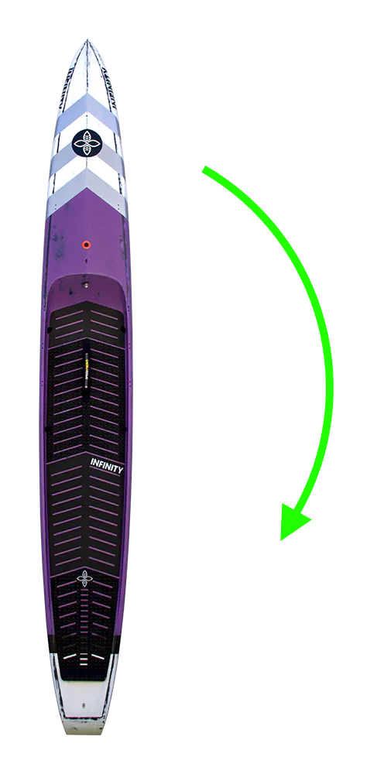
Turn Faster
Bad Buoy
Turns

Slide 21
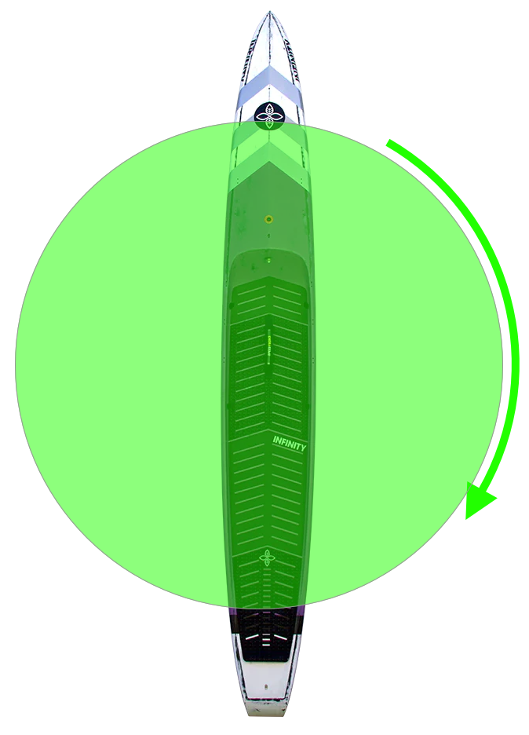
Turn Faster
Bad Buoy
Turns

Slide 22
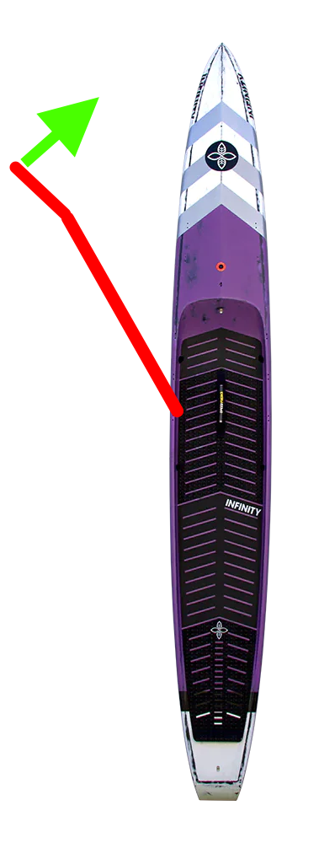
Turn Faster
Cross Bow
Rudder

Slide 23
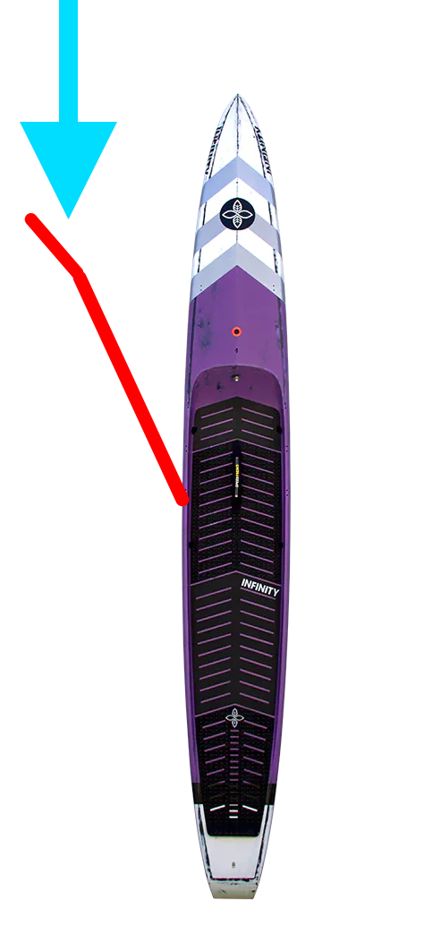
Turn Faster
Cross Bow
Rudder

Slide 24
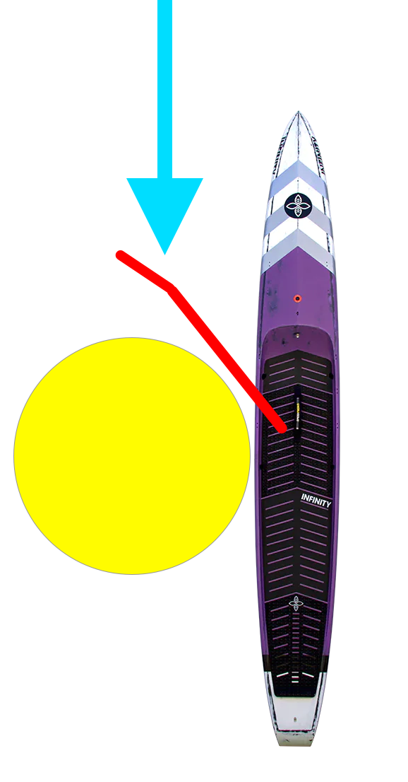
Turn Faster
Cross Bow
Rudder

Slide 25
Turn Faster
Cross Bow
Rudder
https://www.youtube.com/clip/UgkxQAAAK0d-sWT2EZ_YNuz-16scxZoYN9a5

Slide 26

Turn Faster
ICF Worlds
Technical
Finals
2021
https://www.youtube.com/watch?v=mz--ROAUYh0&t=3104s

Slide 27
Exercise of the Week
Passive Shoulder Hangs
https://www.youtube.com/watch?v=hHGC4xuzci4
Notes:
This is a funny one.
When you start paddling each season, it is quite common to end up with shoulder Aches and Pains.
One of the easiest ways to open up your shoulder joint is to simply hang off of something from your hands.
This is the easiest way to get rid of most of those aches.

Slide 28
Exercise of the Week
Chin Up Bar
A kids playground with climbing bars or swings (Only do this if you are actually at the playground with your kids...)
Door Frames Stand on something that lets you get your fingers over the top of a door frame You don’t need your entire weight on it, but enough to stretch out your shoulders Make sure the door frame will take the strain first :-o
TRX If you have TRX Straps then this is great Shorten them as much as possible and hold the handles whilst sticking your bum back until your arms are stretched out above you.
Lat Pulldown machine in the gym Just set the weight to Max and swing from the bar. (Be ready for people ”helpfully” telling you, that your meant to use less weight)
Tree’s These are my favourite :-)
Walls These can hurt though
Any railing or post that is firmly embedded in the ground. This is like hanging but horizontally Grab the post at Waist height. Walk Backwards until your body and arms are stretched out almost horizontally

Slide 29
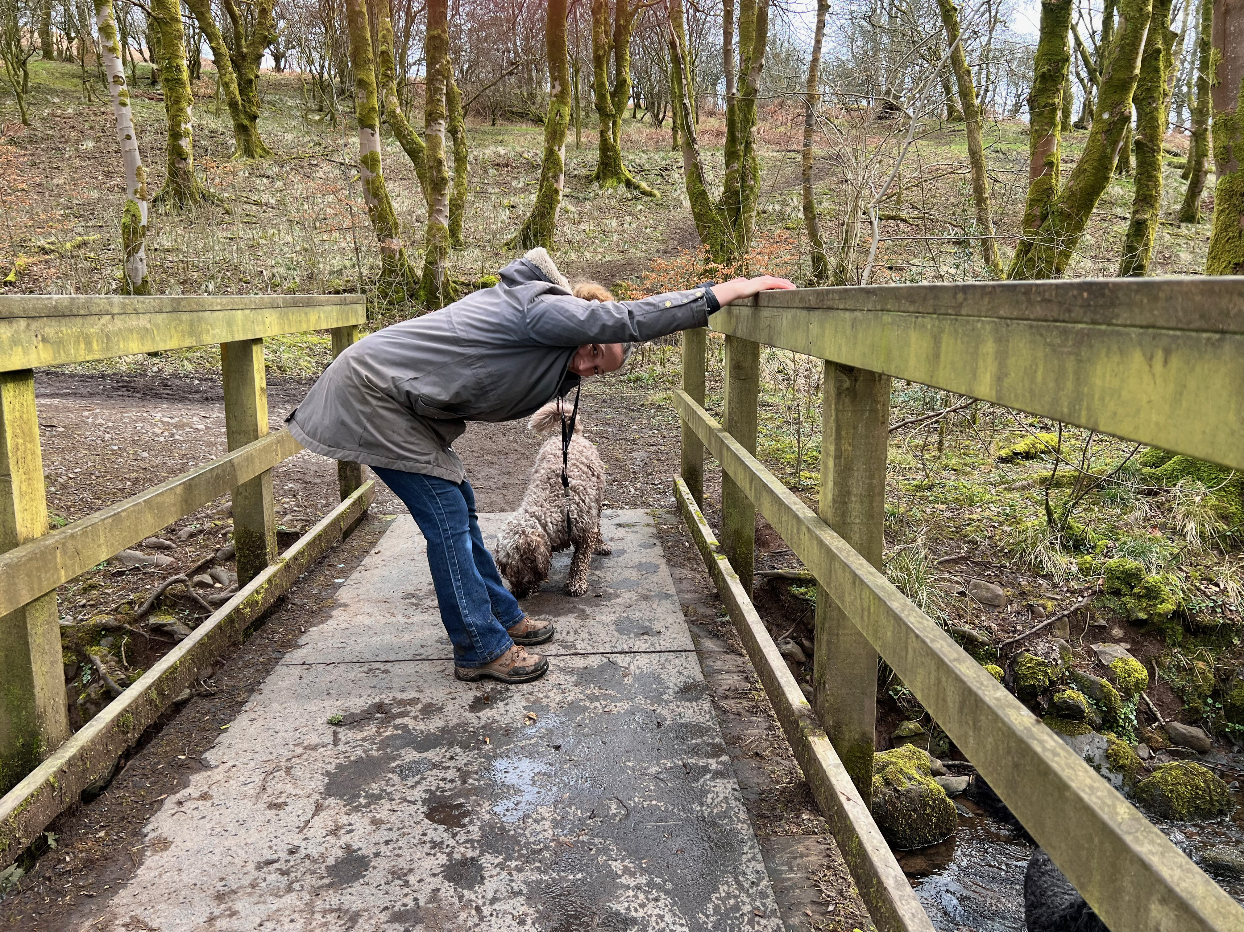
Exercise of the Week

Slide 30
Key Races
Have a look at all the races you want to do this year.
You will rank them as:
A: These are your key races. The whole year is geared around these.
B: These are still competitive races but should not be allowed to derail training
C: These are races that you treat as a training session.

Slide 31
Yearly Plans
Calendar them out and work out how much time you have until the first key race.
Decide what you want to improve between now and that race.
Start working backwards from the date adding in relevant blocks.

Slide 32
Yearly Plans
The plan will be made up of focussed training blocks that fit together into a periodised plan
The block focus will be on one of these:
Base
Building
Maintaining
Taper and Race
Recover
For each of your “A” races, you work backwards.
The last week before a race is the Taper Phase
Building Phases come before that to change your performance to match that race
Base Phases come before Building to get a solid base of miles under your belt.

Slide 33
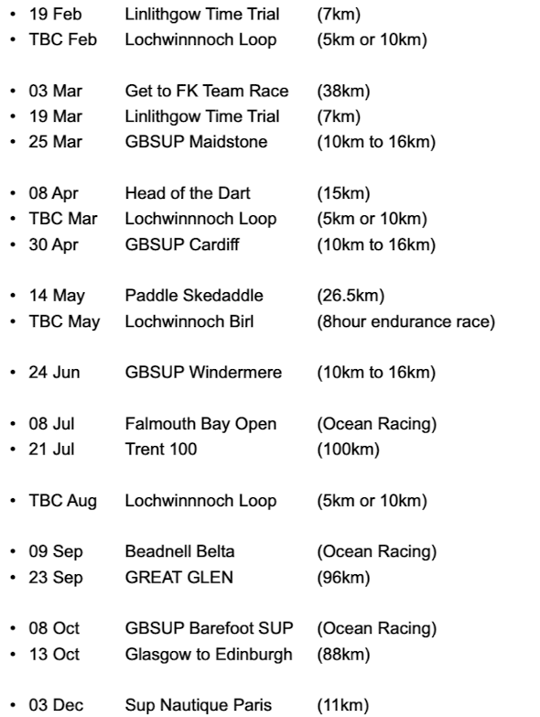
Yearly Plans

Slide 34
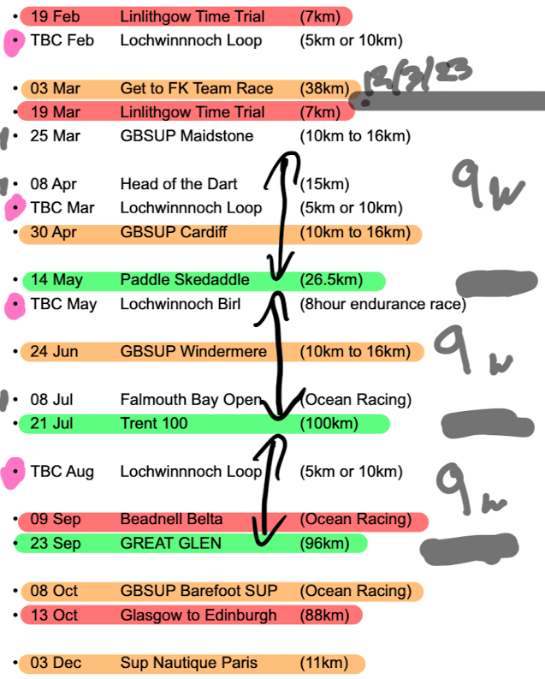
Yearly Plans

Slide 35
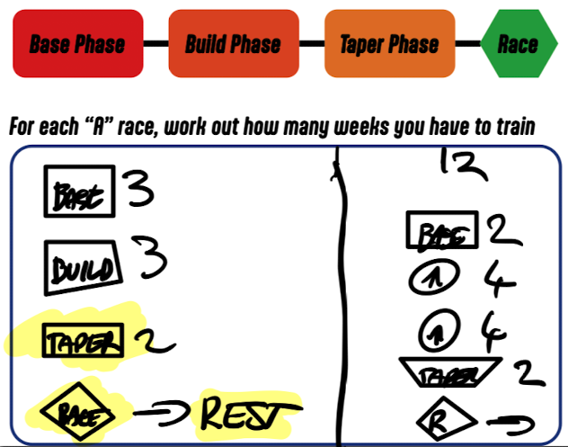
Yearly Plans

Slide 36
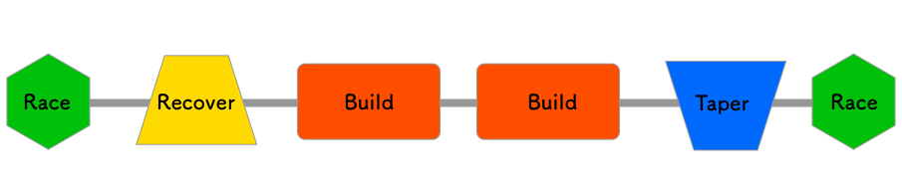
Yearly Plans

Slide 37
Mindset
Mindset Basics
Your mental skills are probably more important than physical ones
They seem harder to train
They are not really that hard but ARE very poorly understood
This week we will cover some basic areas to start thinking about:

Slide 38
Sabotage
Everyone sabotages themselves all the time.
It’s our natural mechanism for making us quit before we do something really stupid and get ourselves killed.
It is evolved for chasing mammoths, but a bit over the top for your average SUP race
We must learn to recognise “when the self sabotage mechanism is limiting us too much”

Slide 39
Sabotage
Investigate our actions and emotions
We need to learn to review how we react to situations
We then need to catalogue them and decide if we react well to them
After this we plan how we “want to react” to them in the future

Slide 40
Goals
Volunteering at a race
Entering your first race
Actually turning up at the first race (Not the same as entering 😐 )
Finishing your first race
Hitting a certain time target
Improving your time
Racing with friends
Beating your friends (you are getting hooked)
Beating other people
Training with Friends
Having Fun
Getting Fitter
Feeling better about yourself
Joining a community and meeting new people
Publishing your times (Ouch. You’ve got it bad now)
Writing articles
Writing a book (You are a lost cause)

Slide 41
Goals
Achieving our goals and dreams is fantastic, but that's not the most important thing about setting goals.
The most important thing is the type of person that we become along the way.

Slide 42
Beliefs
Is your image of yourself.
Is inward looking
Is an idealised version of yourself
May be accurate, or not
Often only looks at the good stuff

Slide 43
Limiting Beliefs
What beliefs stop you performing as well as you dream of

Slide 44
Trust
Trust is how that self image reacts with the real world
It is a fuller picture built up with the benefit of experience
It is more realistic
Sometimes it really sucks
It may be the basis of your self improvement plan. (Things you want to fix)

Slide 45
Trust
Stress
Imbalance of
Demand
vs
Perceived Capacity to Respond

Slide 46
Trust
DOUBT
Lowered Perception of Capacity to Respond
TRUST
Calibrated Perception of Capacity to Respond

Slide 47
TOOLKIT Self Talk
To help us react how we want to, we create some cues or sentences, (self talk), to prompt us how to react when they occur.
Start to use this Self Talk to prompt your behaviour into new patterns.
Review how well each Cue works and tweak them as needed
Notes:
Instructional or Motivational

Slide 48
TOOLKIT Homework
Think about your relationship with:
Sabotage
Beliefs
Limiting Beliefs
Trust
Self Talk v1

Slide 49
Week 2
Physical Training Patterns
Physical Transformation
On the water Skills: Recovery and Catch
Motivation: You have to know your WHY
Mental Resilience Toolkit Part 2
Limiting Beliefs
Hopes
Fears
Self Talk Part 2
Homework Exercise :-o

Slide 50
Week 3
Feedback and Awareness: How to use them to drive improvements
Training Peaks: Managing Goals, Sessions, Periodisation
Mental Resilience Toolkit Part 3
Feelings
Breathing
Strengths
Weaknesses
Gratitude
TRUST
Personal Performance Statement
Why Race (Revisited)

Slide 51
fin

